Slide 1
Keylogger & security
Presented By:
K.Mohan (AU810621104014)
Computer Science and Engineering
Dr.Navalar Nedunchezhiyan College Of Engineering

Slide 2
OUTLINE
Definition
System Development Approach
Implementation
Result (Output Image)
Conclusion
Benefits
References

Slide 3
Definition:
A keylogger, short for "keystroke logger," is a type of software or hardware device designed to secretly record every keystroke made on a computer or mobile device. Keyloggers can capture a wide range of user activity, including passwords, usernames, messages, emails, websites visited, and any other text input.
Keyloggers are often used for legitimate purposes such as monitoring children's online activities, tracking employee productivity, or troubleshooting technical issues. However, they can also be used maliciously by hackers or cybercriminals to steal sensitive information such as login credentials, financial data, or personal information.

Slide 4
Problem statement:
Detection Challenges:
Keyloggers can operate stealthily, making them difficult to detect using conventional security measures. They may evade antivirus software and remain undetected for extended periods, posing a significant threat to user privacy and security.
Prevention Measures:
Preventing keylogger installations requires robust security practices, including secure software development, user education, and endpoint security solutions. However, even with preventive measures in place, sophisticated attackers may still find ways to circumvent defenses and install keyloggers on targeted systems.
User Privacy Concerns:
While keyloggers can be used for legitimate purposes such as monitoring employee activity or parental controls, they also raise significant privacy concerns. Users may be uncomfortable with the idea of their keystrokes being recorded and potentially used without their consent, leading to trust issues and legal implications.

Slide 5
System Approach:
System requirements:
Python IDLE.
Library required to build the model:
pip install pynput.
pip install jsonlib.

Slide 6

Implementation :

Slide 7
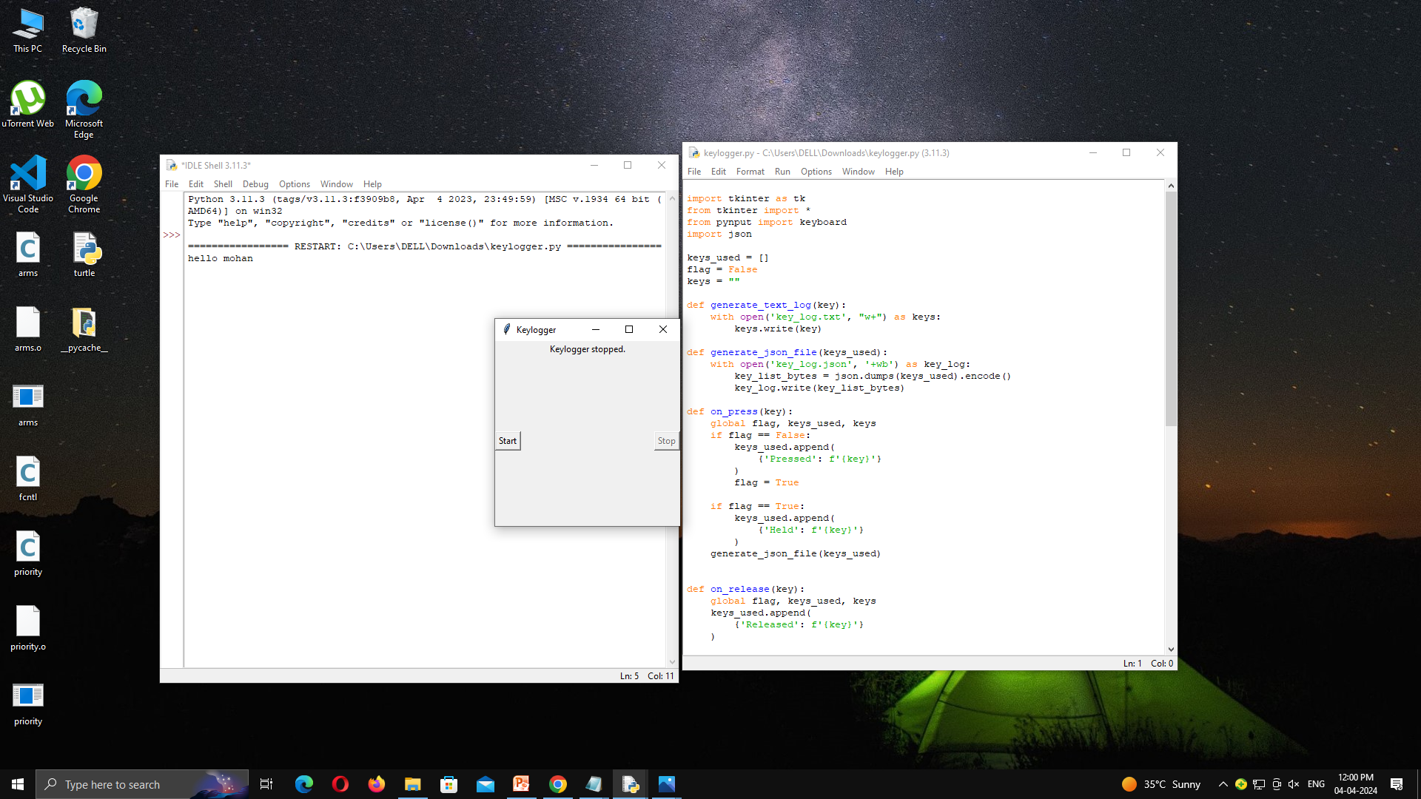

Output:

Slide 8
Conclusion:
Hardware Solutions:
Implementing secure input devices, physical security measures, and regular inspections to prevent the installation and detection of hardware keyloggers.
Software Solutions:
Utilizing antivirus and antimalware software, firewalls, endpoint security solutions, and behavioral analysis techniques to detect and remove software-based keyloggers, block unauthorized network traffic, and identify abnormal behavioral patterns indicative of keylogging activity.

Slide 9
Benefits:
Detection and Prevention of Unauthorized Access:
Keylogger security measures can help detect and prevent unauthorized access to sensitive information by identifying and blocking keylogging activity. This can safeguard personal and confidential data from being captured and exploited by malicious actors.
Protection Against Insider Threats:
Keylogger security solutions can help organizations monitor and mitigate insider threats, such as employees or contractors attempting to steal sensitive information or engage in unauthorized activities. By detecting suspicious behavior and unauthorized keystroke logging, organizations can prevent data breaches and internal security incidents.
Enhanced Endpoint Security:
Implementing keylogger security measures as part of endpoint security solutions can strengthen overall security posture. By detecting and removing keyloggers from individual devices, organizations can mitigate the risk of malware infections and unauthorized access to corporate networks and resources.

Slide 10
References:
Scholarly Journals and Academic Papers:
Search academic databases such as Google Scholar, IEEE Xplore, or ACM Digital Library for research papers on keylogger security. Look for articles published in peer-reviewed journals and conferences in the fields of cybersecurity, computer science, and information security.
Books:
Check for books on cybersecurity and information security that cover topics related to keylogger security. Some recommended titles include "Principles of Computer Security" by Conklin et al., "Hacking Exposed" by McClure et al., and "The Web Application Hacker's Handbook" by Stuttard and Pinto.

Slide 11
THANKING YOU…

